Slide 1
Operators-- MongoDB
--Govardhan R S
161086

Slide 2
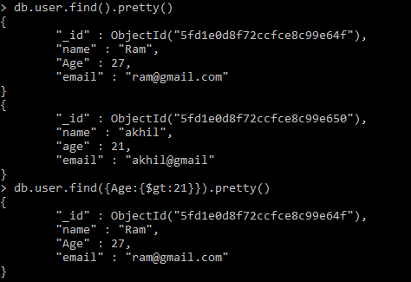
Query Selector----Comparison operator

Slide 3
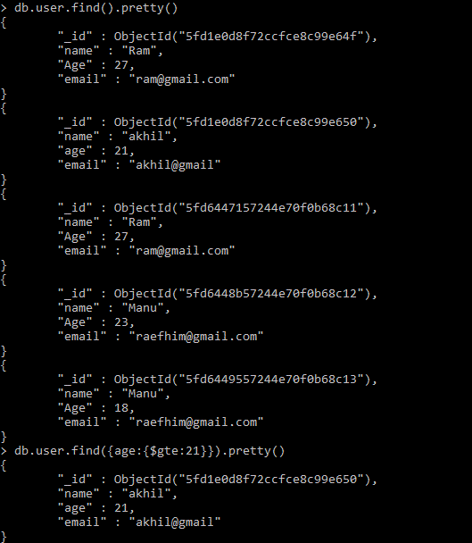
GreaterThan or equal

Slide 4
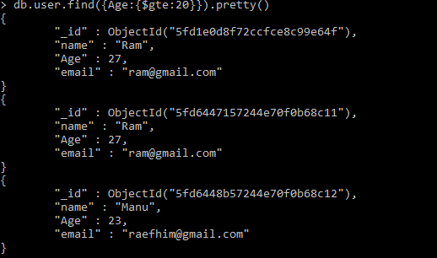

Slide 5
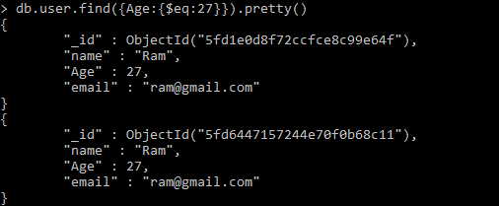

Slide 6
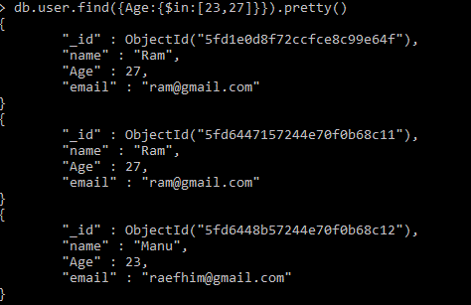

Slide 7


Slide 8
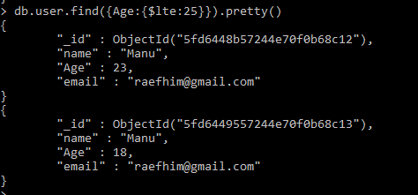

Slide 9
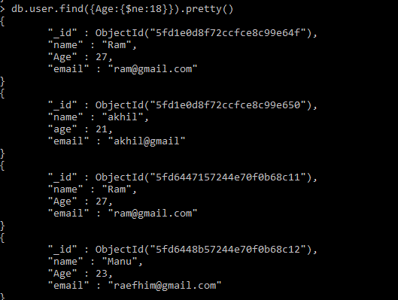

Slide 10
Logical operators

Slide 11

NOR and OR

Slide 12

AND

Slide 13

NOT

Slide 14
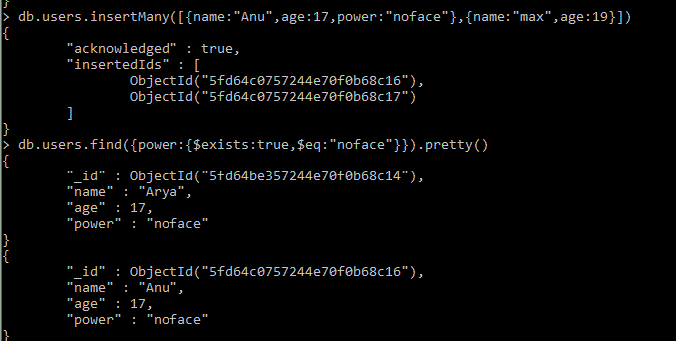
Element Operations

Slide 15
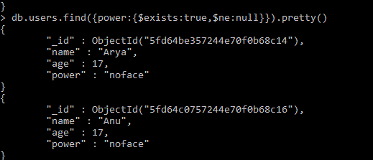
Element Operations

Slide 16
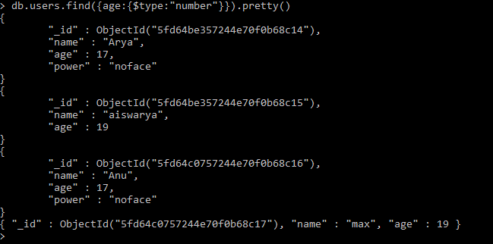
Element Operations

